Slide 1
CSE428: Image Processing
Lecture 4: Point Processing - Part 1

Slide 2
Spatial Image Processing
Introduction
Typical image processing pipeline
Transform
Transformed Image
Processing
Transform: pixel values in some other, but equivalent form.
For example, fourier, wavelet, unity (no transform)
Spatial processing: direct manipulation of pixels (i.e. unity transform)
g(x, y) = T [f(x, y)], where f = input image, g = output image, T[] = mapping function
Scope: (i) Enhancement - improved visual quality (ii) Improved recognition rate

Slide 3
Spatial Image Processing
Types
Point Processing
Operation
Input image, f(x, y)
Output image, g(x, y)

Slide 4
Spatial Image Processing
Types
Neighborhood Processing (Filtering)
Operation
3✕3 neighbor
Input image, f(x, y)
Output image, g(x, y)

Slide 5
Spatial Image Processing
Types
Global Processing
Operation
Input image, f(x, y)
Output image, g(x, y)

Slide 6
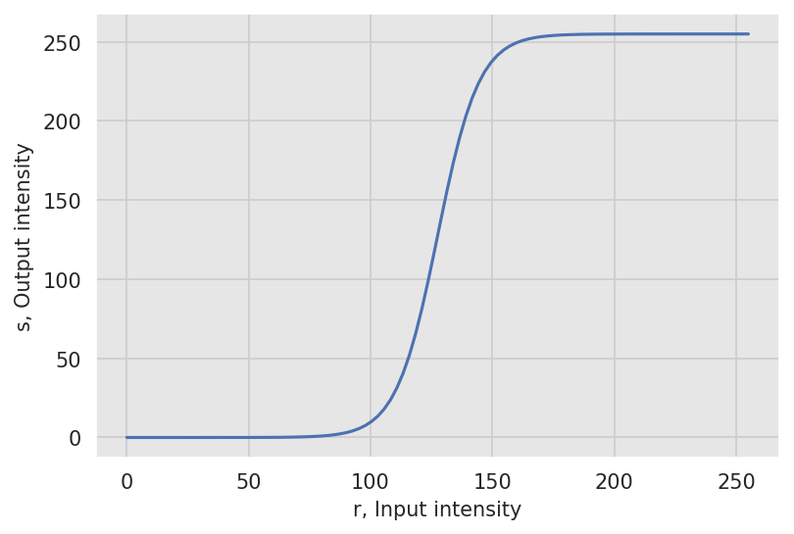
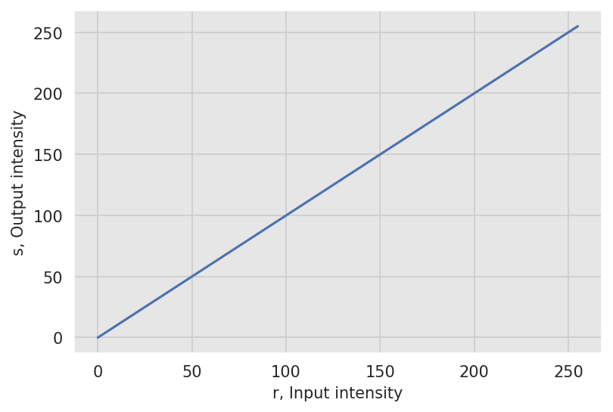
Mapping Function
s = T [r], where r = input intensity, s = output intensity, T[] = mapping function
Mapping functions can be visualized graphically
Contrast stretching
Unity mapping

Slide 7


Mapping Function
Will consider [0, 1] range for simplicity
Contrast stretching
Unity mapping

Slide 8
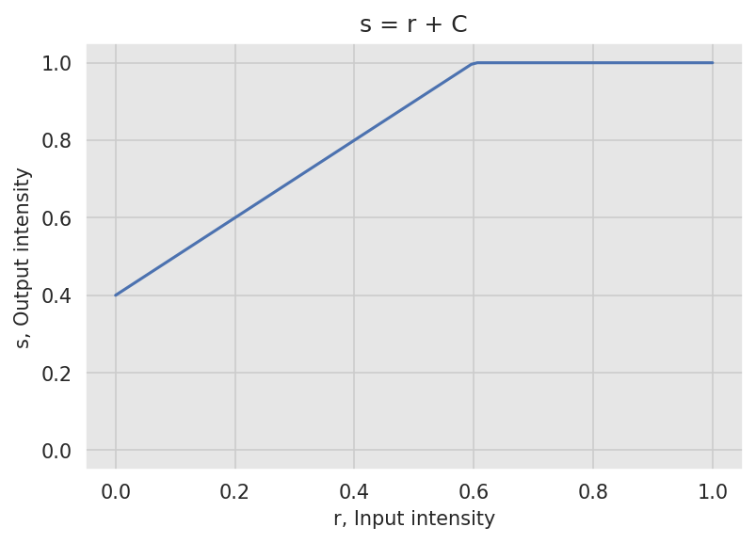
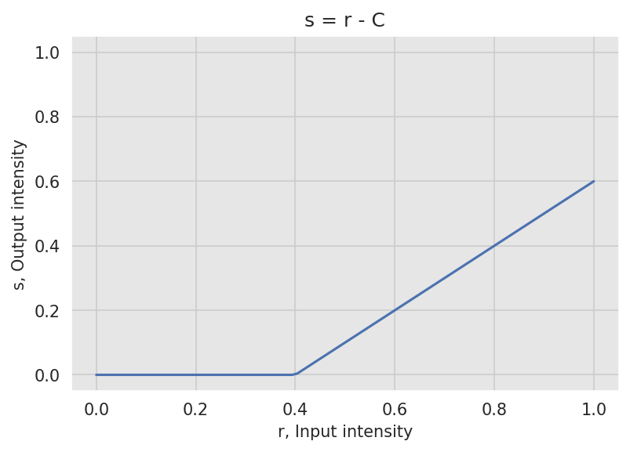
Arithmetic Operations
Addition and Subtraction - Brightness Adjustment
s = r ± C, where r = input intensity, s = output intensity, C = a positive constant
Have to make sure the outputs are clipped between [0, 1]
Increases (+) or decreases (-) the overall brightness

Slide 9
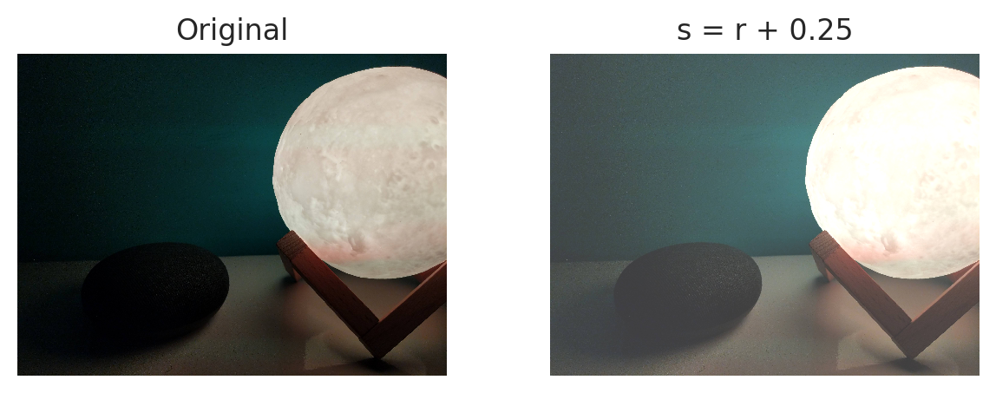
Arithmetic Operations
Addition and Subtraction - Brightness Adjustment
Addition might saturate high intensity levels

Slide 10
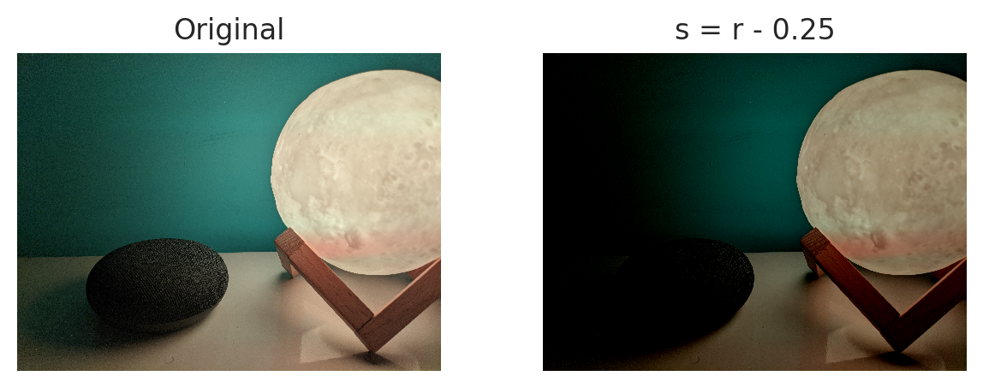
Arithmetic Operations
Addition and Subtraction - Brightness Adjustment
Subtraction might saturate low intensity levels

Slide 11
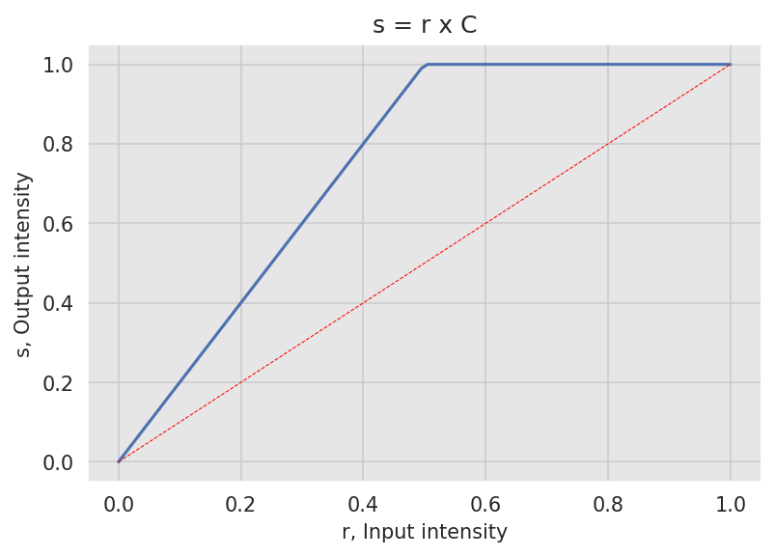
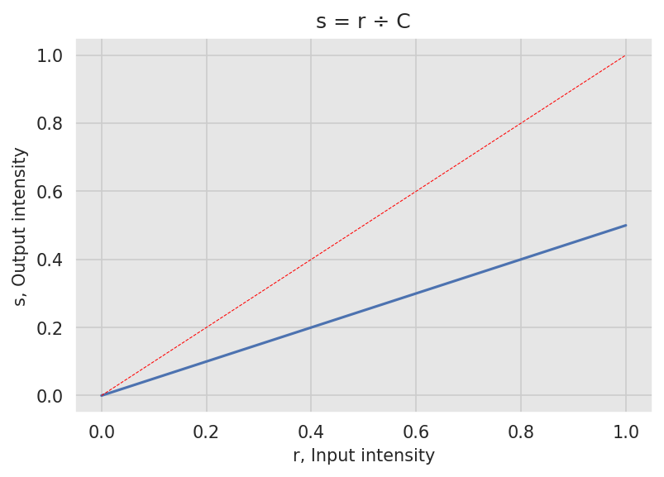
Arithmetic Operations
Multiplication and Division - Contrast Adjustment
s = r ✕ C or r ÷ C, r = input intensity, s = output intensity, C = a positive constant
Have to make sure the outputs are clipped between [0, 1]
Combined with addition/subtraction, can be used for contrast adjustment

Slide 12
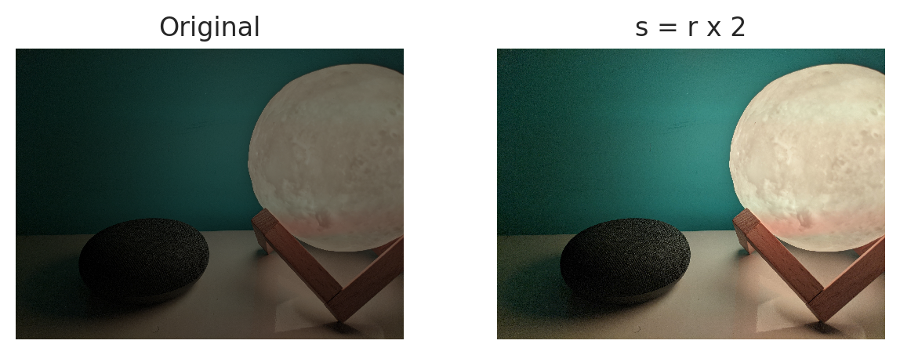
Arithmetic Operations
Multiplication and Division - Contrast Adjustment
Overall brightness increased, contrast increased

Slide 13
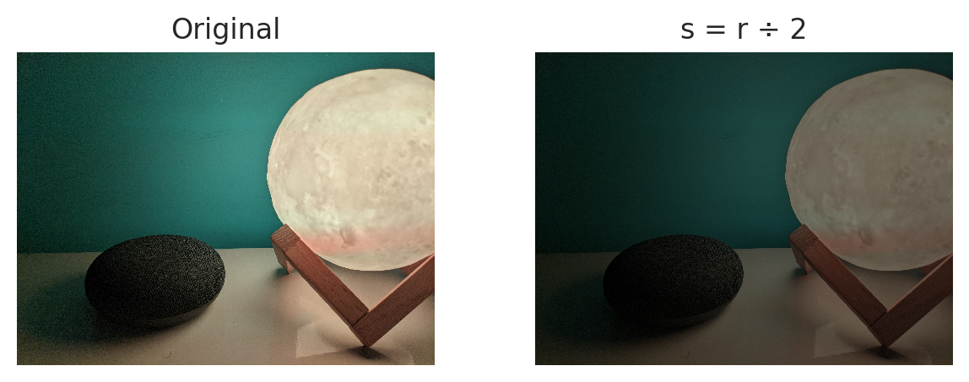
Arithmetic Operations
Multiplication and Division - Contrast Adjustment
Overall brightness decreased, contrast decreased

Slide 14
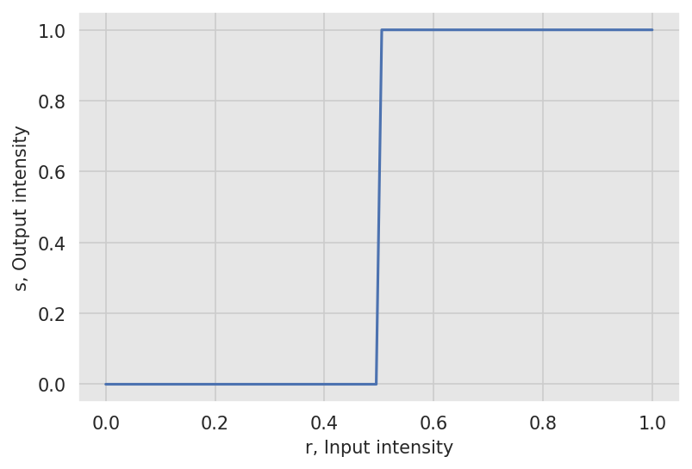
Contrast Stretching
A wide range near black/white is compressed to a corresponding narrow range
A small range near the middle is expanded to a wide range
Limiting case of contrast stretching is thresholding. Produces binary image.
Contrast stretching
Thresholding

Slide 15
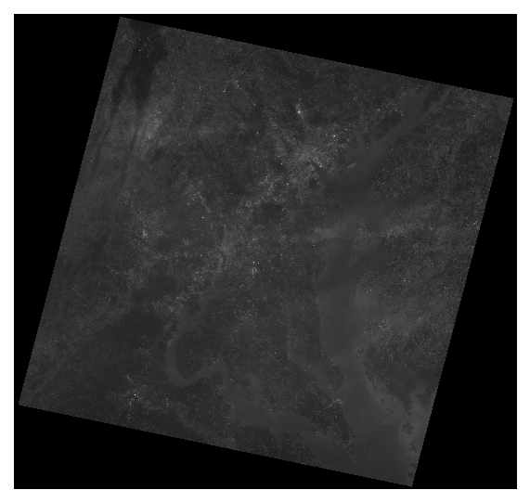
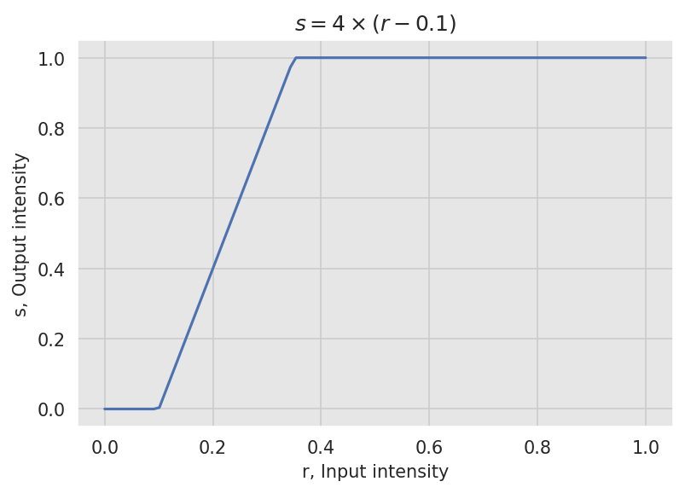
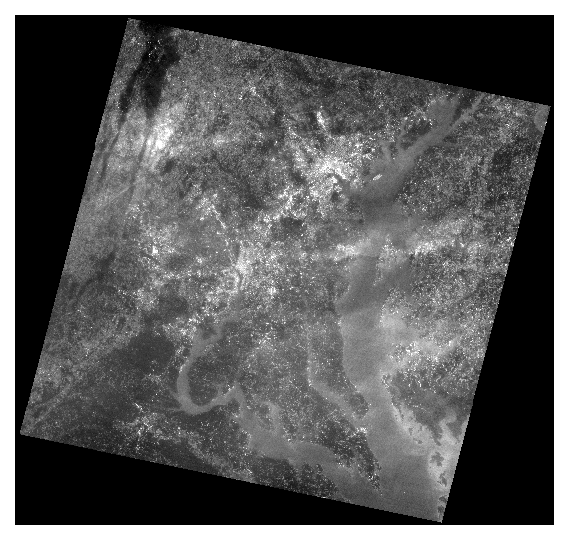
Contrast Stretching
Using arithmetic operation
s = C₁ ✕ (r - C₂ )
Some loss of information near low and high intensity levels
Input image (LANDSAT band 1)
Stretching function
Output image

Slide 16
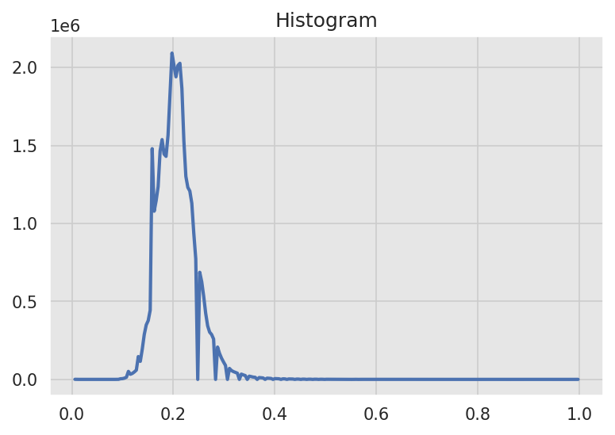

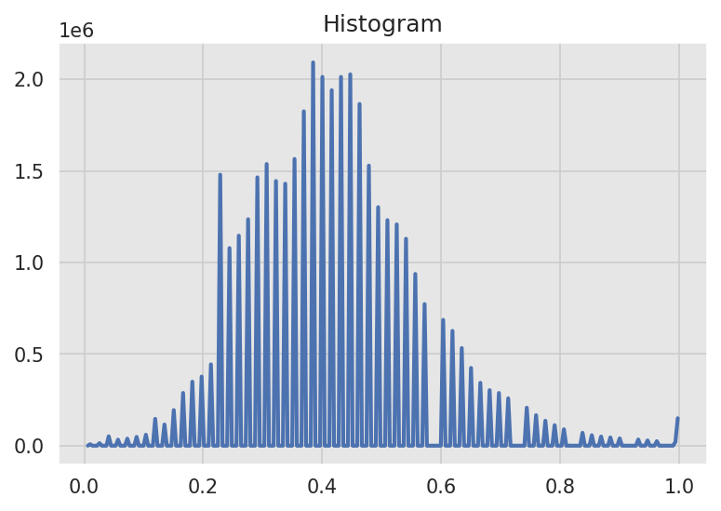
Contrast Stretching
Using arithmetic operation
How to calculate C₁ and C₂ ?
Histogram of I
Histogram of (I-0.1)
Histogram of 4x(I-0.1)

Slide 17
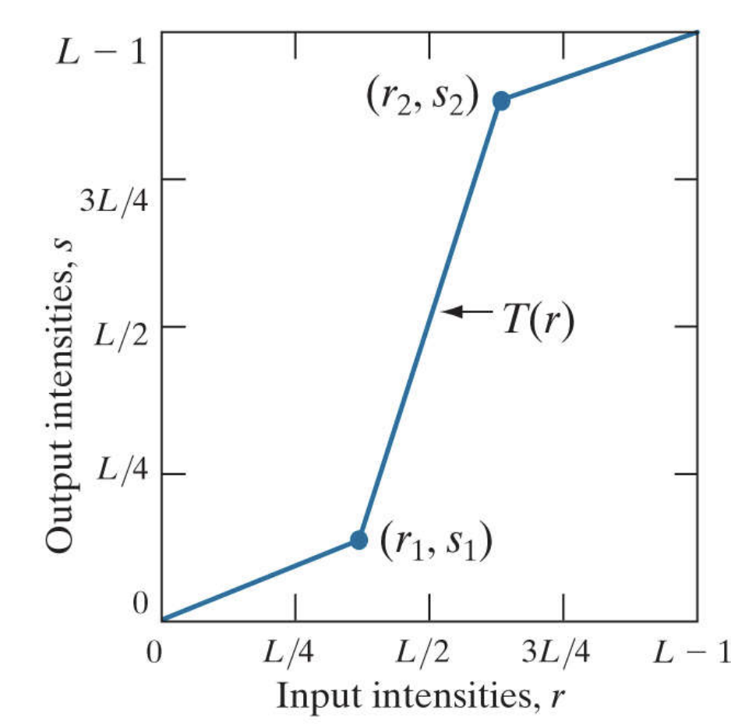
Contrast Stretching
Using Piecewise Linear Mapping
[0, r₁ ] is mapped to [0, s₁ ] where s₁< r₁ [Compressed]
[r₂ , 1] is mapped to [s₂ , 1] where s₂> r₂ [Compressed]
[r₁ , r₂ ] is mapped to [s₁, s₂ ] [Stretched]
No clipping, hence no loss of information
By Rafael C. Gonzalez & Richard E. Woods, 2018, Digital Image Processing, 4th Edition

Slide 18
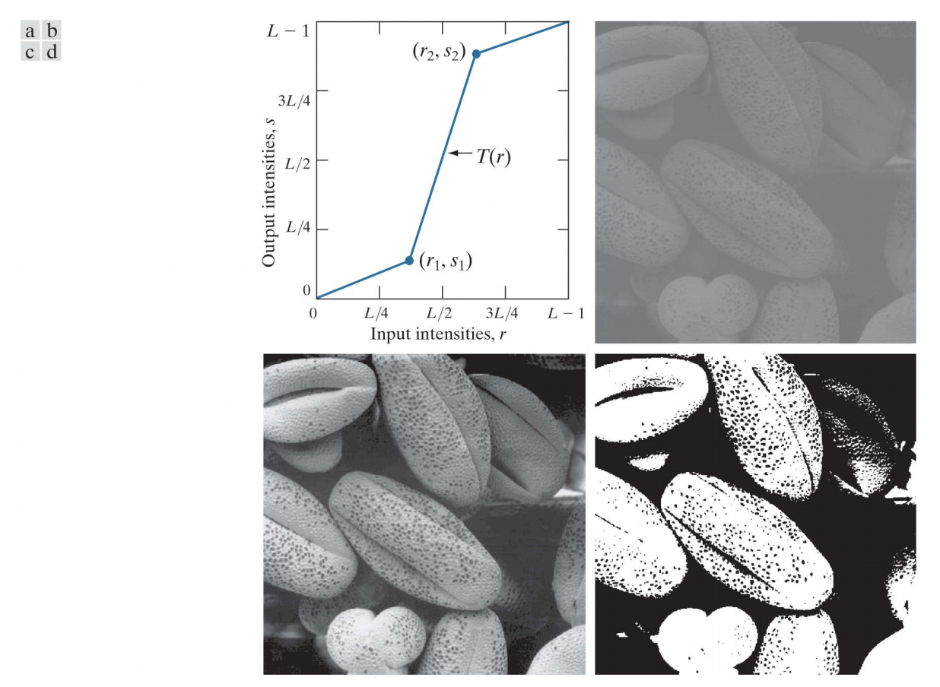
Contrast Stretching
Using Piecewise Linear Mapping
(a) Piecewise linear transformation function. (b) A low-contrast electron microscope image of pollen, magnified 700 times. (c) Result of contrast stretching. (d) Result of thresholding. (Original image courtesy of Dr. Roger Heady, Research School of Biological Sciences, Australian National University, Canberra, Australia.)
By Rafael C. Gonzalez & Richard E. Woods, 2018, Digital Image Processing, 4th Edition

Slide 19
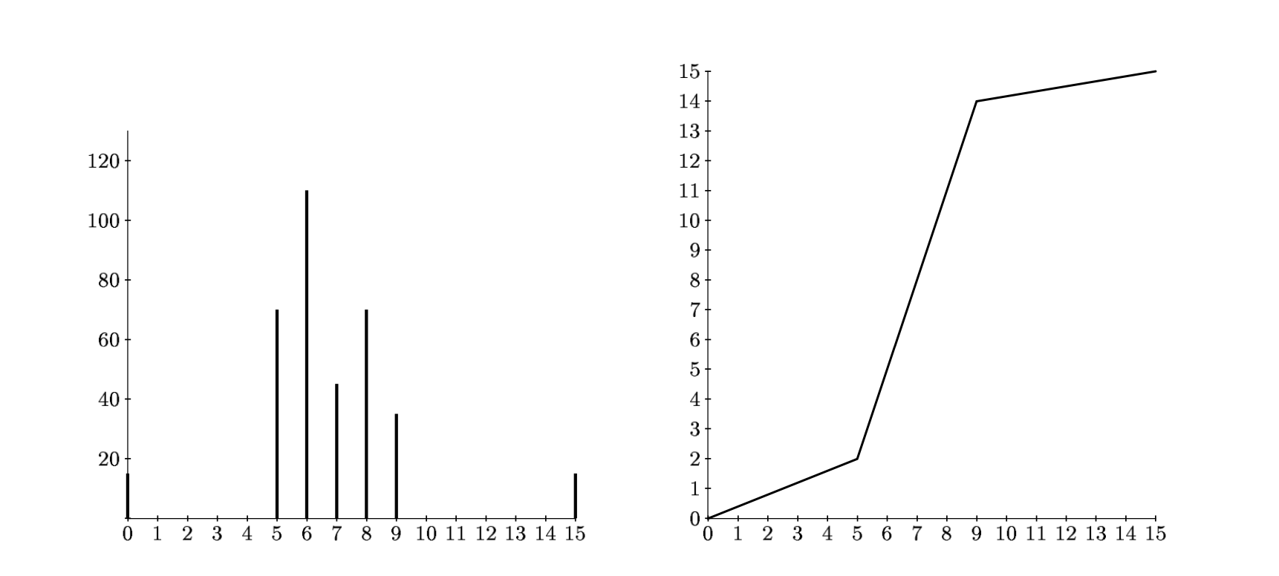
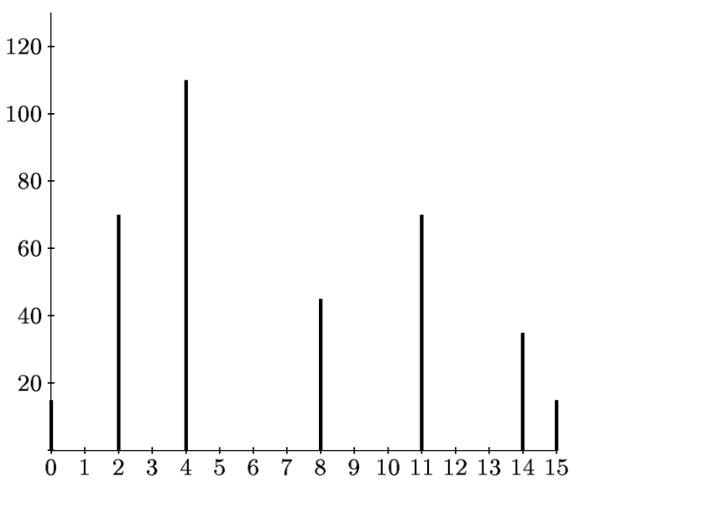
Intensity Transformation
What is happening
Example Histogram
r | 0 | 1 | 2 | 3 | 4 | 5 | 6 | 7 | 8 | 9 | 10 | 11 | 12 | 13 | 14 | 15
n_{r} | 15 | 0 | 0 | 0 | 0 | 70 | 110 | 45 | 70 | 35 | 0 | 0 | 0 | 0 | 0 | 15
Original histogram
Stretching map
Stretched histogram
By Alasdair McAndrew, 2004, An Introduction to Digital Image Processing with Matlab: Notes for SCM2511 Image Processing 1

Slide 20
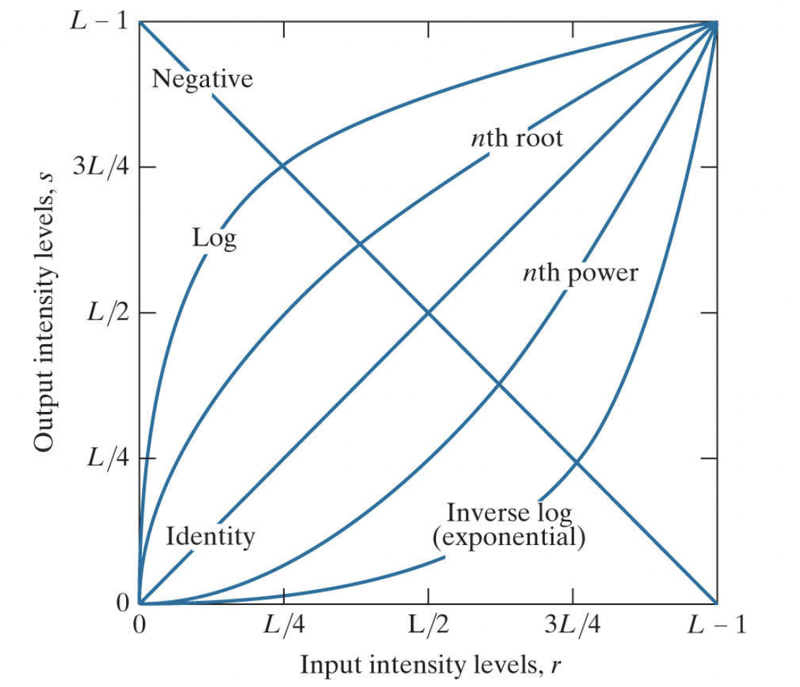
Intensity Transformation
Basic transformations
By Rafael C. Gonzalez & Richard E. Woods, 2018, Digital Image Processing, 4th Edition

Slide 21
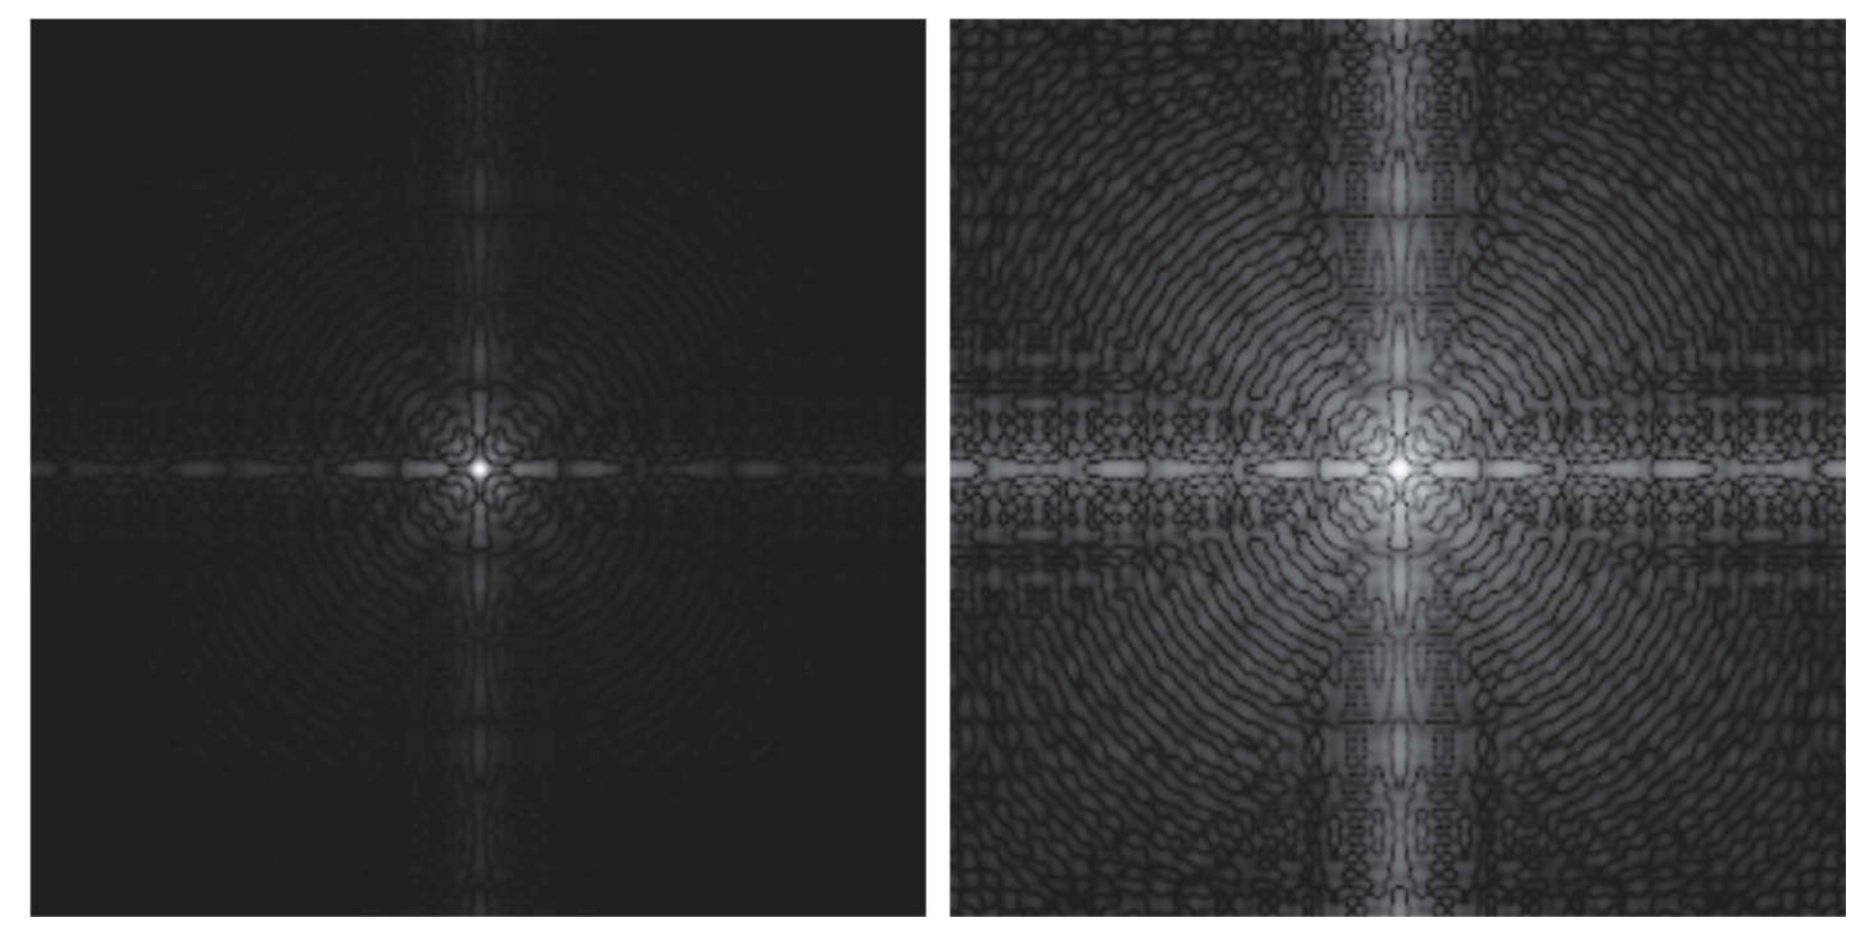
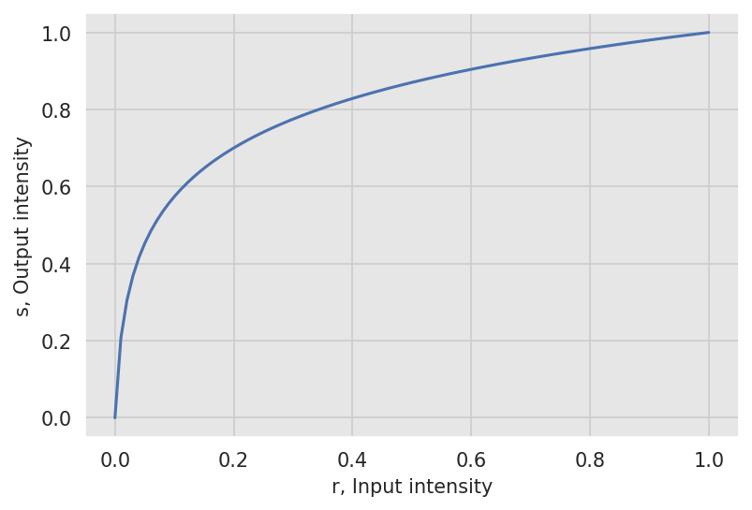
Intensity Transformation
Log Transformation - Dynamic Range Compression
By Rafael C. Gonzalez & Richard E. Woods, 2018, Digital Image Processing, 4th Edition
s = c log(1 + r), r ≥ 0, c ≥ 0
Low range gray levels expanded
High range gray levels compressed
^ Visualization of fourier spectra of an image before and after log compression

Slide 22
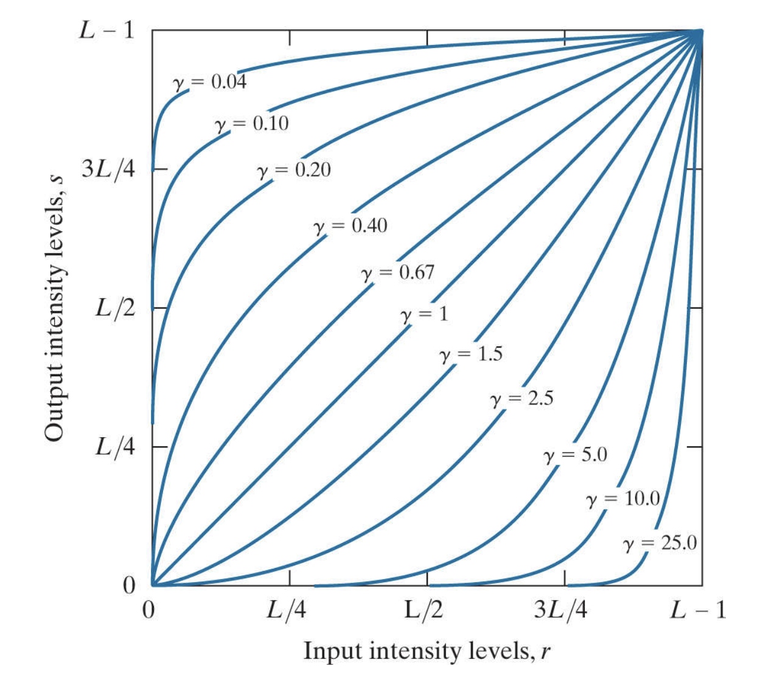
Intensity Transformation
Power Law Transformation
s = cr^{γ}, r ≥ 0, c, γ > 0
A generalized version of log transformation
γ > 1 Inverse log transformation, dynamic range expansion
γ < 1 Log transformation, dynamic range compression
By Rafael C. Gonzalez & Richard E. Woods, 2018, Digital Image Processing, 4th Edition

Slide 23
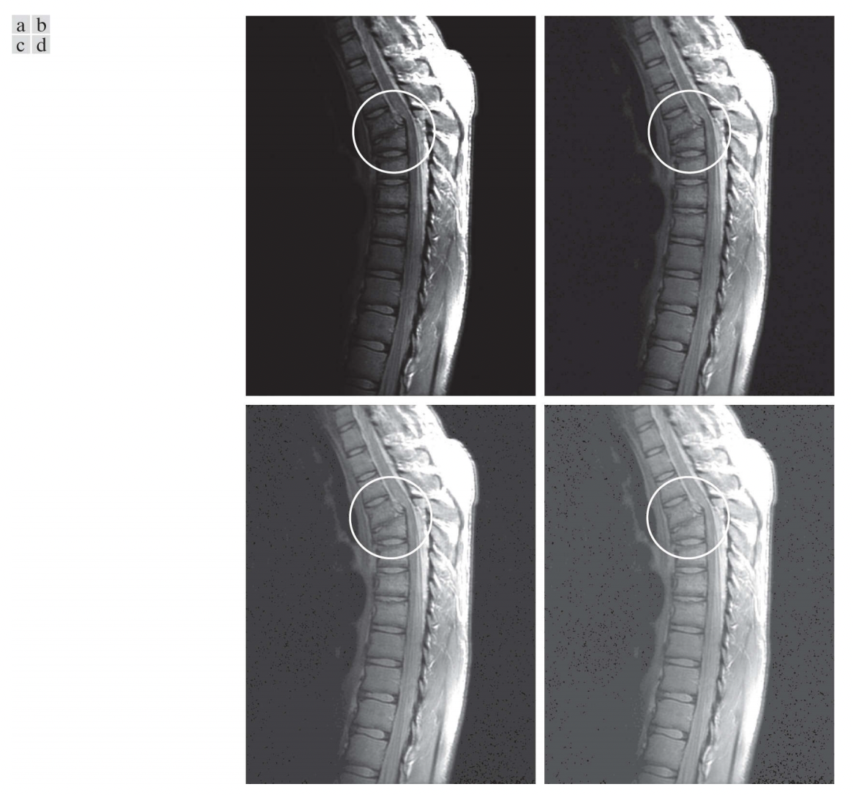
Intensity Transformation
Power Law Transformation - Dynamic Range Compression
(a) Magnetic resonance image (MRI) of a fractured human spine (the region of the fracture is enclosed by the circle). (b)–(d) Results of applying the transformation in Eq. (3-5) with c = 1 and γ = 0.6, 0.4, 0.3, respectively.
(Original image courtesy of Dr. David R. Pickens, Department of Radiology and Radiological Sciences, Vanderbilt University Medical Center.)
By Rafael C. Gonzalez & Richard E. Woods, 2018, Digital Image Processing, 4th Edition

Slide 24
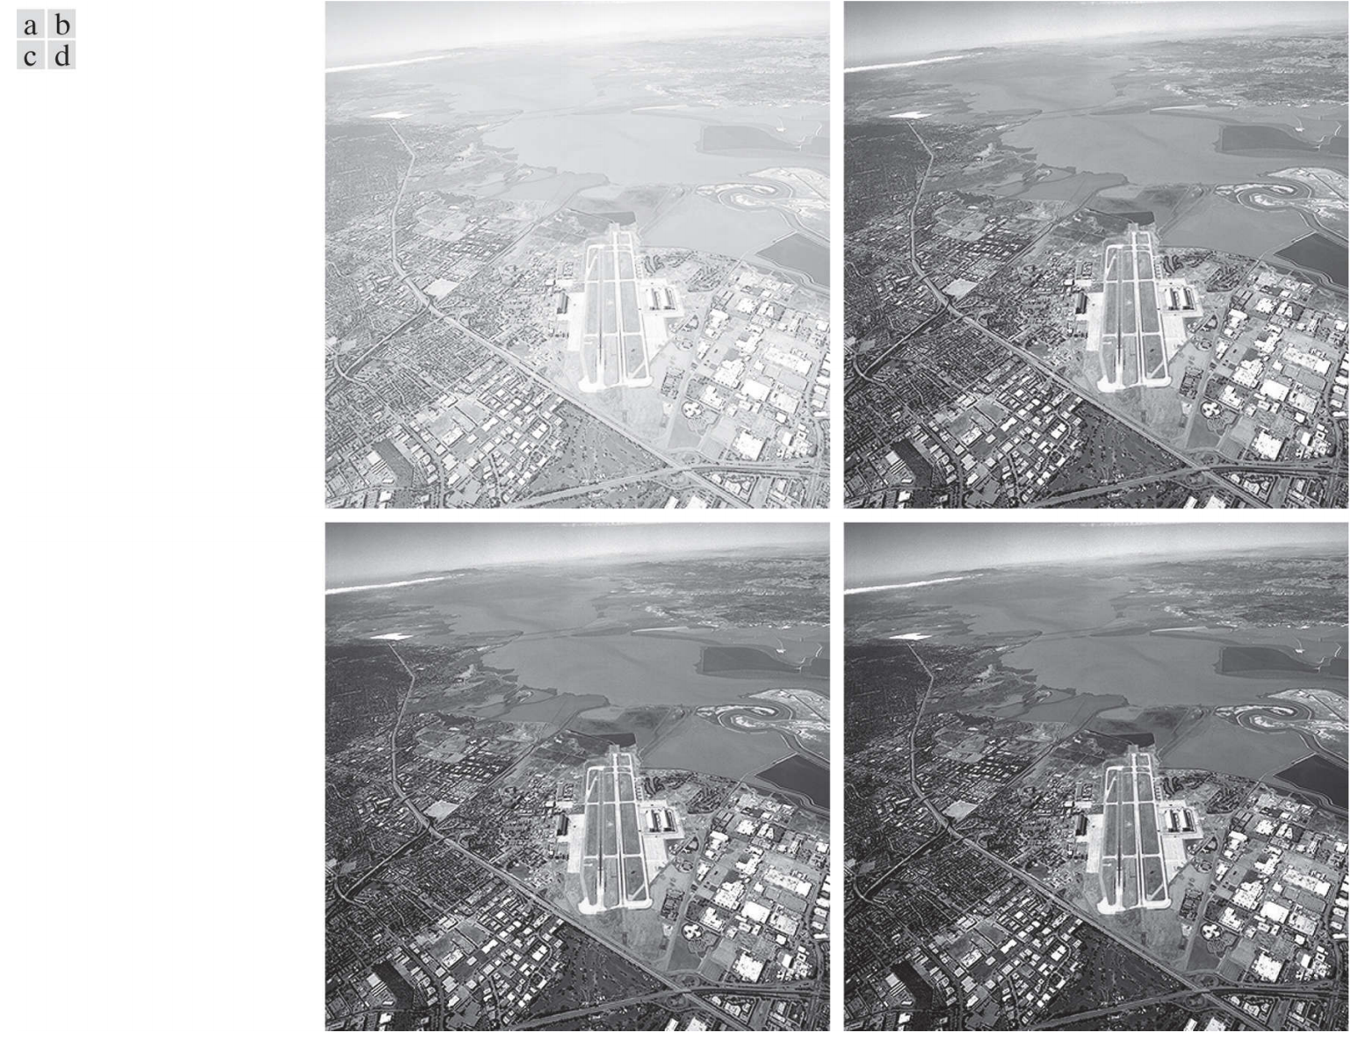
Intensity Transformation
Power Law Transformation - Dynamic Range Expansion
(a) Ariel Image (b)–(d) Results of applying the transformation in Eq. (3-5) with c = 1 and γ = 3, 4, 5, respectively.
(Original image courtesy of NAS)
By Rafael C. Gonzalez & Richard E. Woods, 2018, Digital Image Processing, 4th Edition

Slide 25
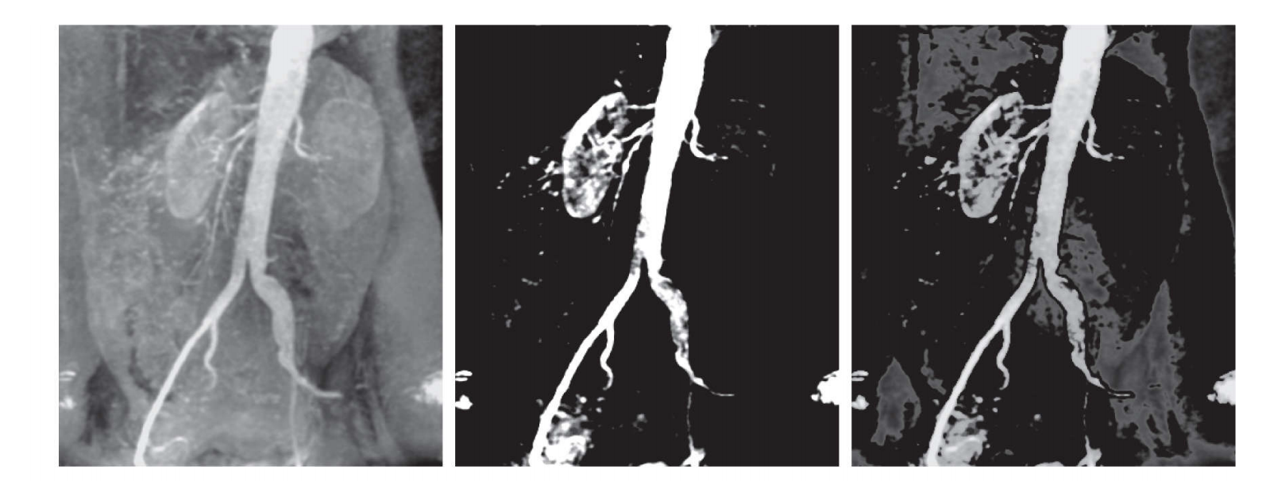
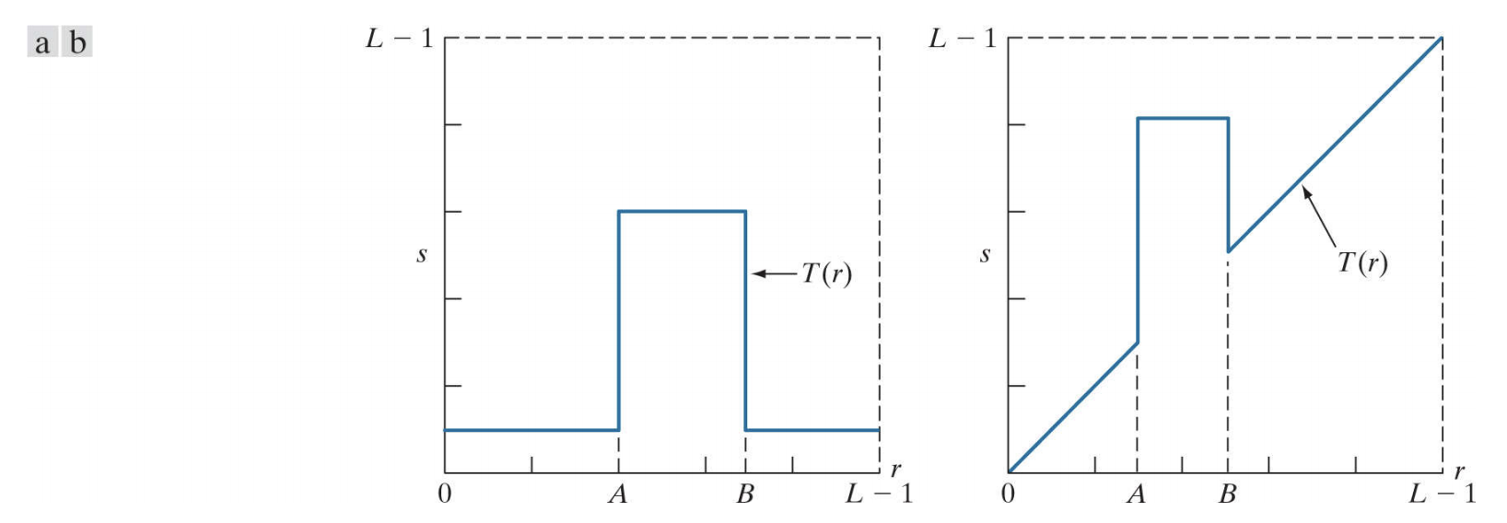
Intensity Transformation
Gray-Level Slicing
By Rafael C. Gonzalez & Richard E. Woods, 2018, Digital Image Processing, 4th Edition

Slide 26
Questions?

